Slide 1
MACHINE LEARNING K-MEANS SAMPLE SUPERSTORE PROJECT

Slide 2
EXECUTIVE SUMMARY
The data set sample super store was sourced from Kaggle and it consist of customer information.
Exploratory data analysis and K-Means Machine learning algorithms was carried out to analyse the data for better understanding and proper recommendations in ither to boost sales.
Frequency shows that customer ID WB-21850 has the highest frequency of 37.
Monetary also showed that customer ID SM-20320 has the highest monetary value of 25043
Recency shows that customers with IDs (JM-15580,EB-13975,PO-18865 and CC-12430) has the most recent visit to the super-store
Technology category of goods has the highest sales of 36%, furniture with 32% and office supplies with 31% respectively.
The west region has the highest sales 31% and south with the lowest sales of 17%.

Slide 3
DATA SET DESCRIPTION
The data consist of 21 columns and 9994 rows which was clear-fully cleaned, studied and explored for insights.
The .isna() was used to remove some empty cell found in the Postal Code column.
The data consist of customer ID, ship mode(consist of 4 different shipping mode), Segment(consumer, corporate and home office and three categories of goods( furniture, Technology and office supplies.

Slide 4
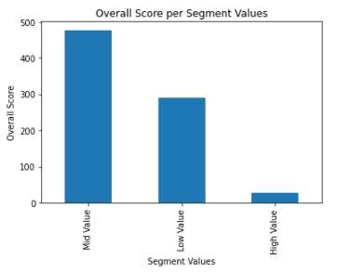
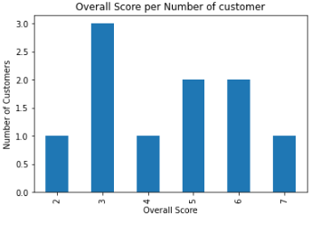
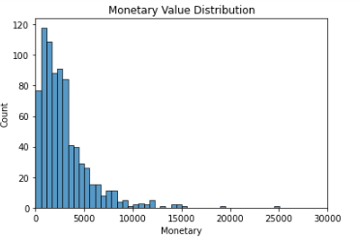
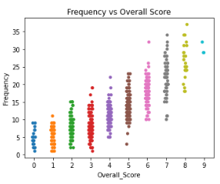
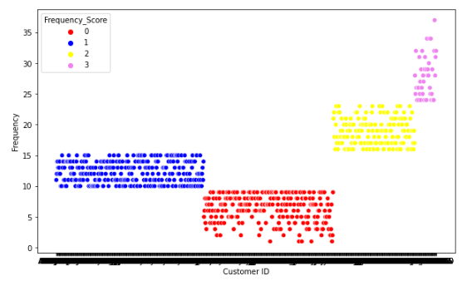
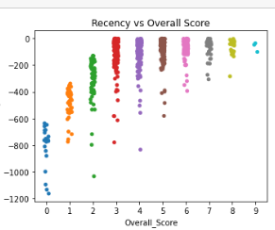
Visualization

Slide 5
CONCLUSION
The analysis reveal that the RFM overall Mid value consist of 60% of the total customer making it the highest cluster and RFM score (3) occurring the most.
The data also showed that the higher the frequency the lower the monetary value of customers, campaign can be targeted at the high value customer in other to increase their frequency which will lead increase in sales.
K-means clusters analysis also reveal that cluster (0) has the lowest frequency and cluster (3) has the highest frequency.
The higher the recency the lower the overall score
Further insight and visualization can the explore in the notebook: Machine Learning K-means Project

